Slide 1

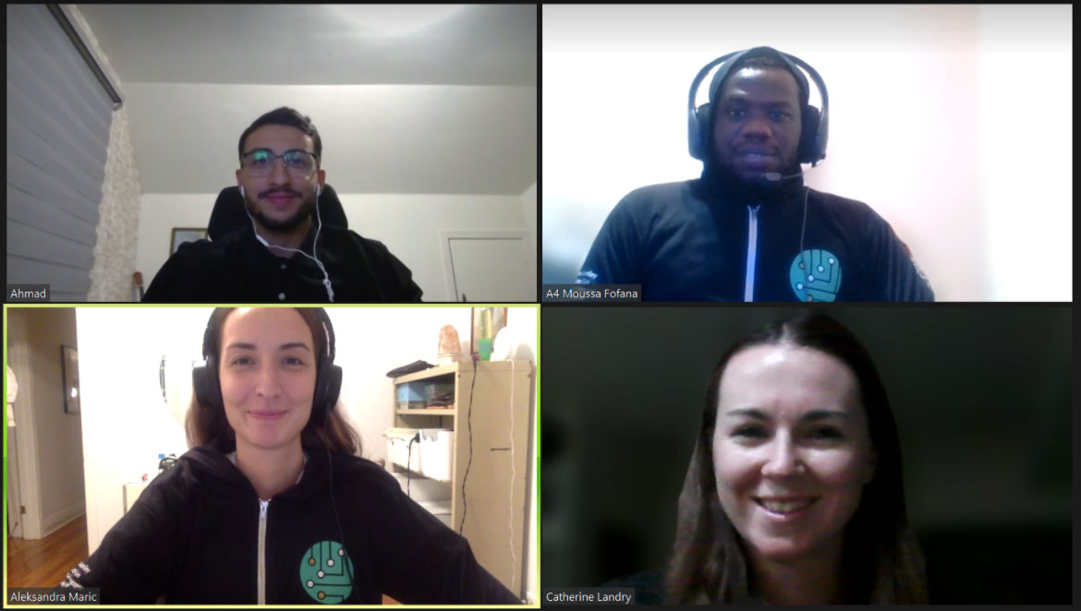
DESTANATION Connect
Ahmad El-Rahim Moussa Fofana
Catherine Landry
Aleksandra Maric
Mentor : Marcel Tawé
DESTA TEAM 04

Slide 2



DESTANATION Connect : A one-stop web app
Customizable dashboard that presents information relevant to the user, either the public or a business, using tags
A forum platform where businesses can exchange ideas and talk to each other one on one, thanks to the chat app
Referral and rewards system which allows DESTA to identify their power users and leverage the knowledge
DESTA TEAM 04

Slide 3
DEMO
DESTA TEAM 04

Slide 4



Next steps
Translate our UI vision into a fully completed web-app
Use ML to target users ever more efficiently
Adding notifications that
DESTA TEAM 04
DESTA TEAM 04
Notes:
Choix de la technologie

Slide 5



Why choose DESTANATION Connect ?
Easy to use and accessible on any device
Robust solution that will require minimal effort from DESTA
Gamification makes the app sticky and helps identify power users
DESTA TEAM 04
DESTA TEAM 04
Notes:
Choix de la technologie

Slide 6
QUESTIONS
DESTA TEAM 04

Slide 7
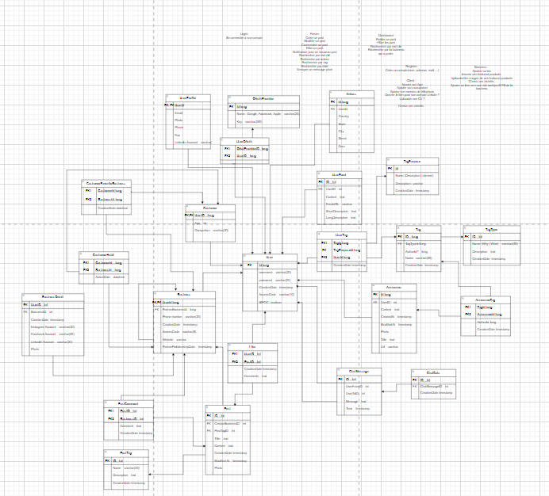
Architecture de données

Slide 8
